Slide 1

Reti di Calcolatori
Daniele Iacomini
Luca Tomei
Andrea Aurizi
2019/2020

Slide 2

OVERVIEW
01.
INTRODUCTION TO COLLIGO
02.
REQUIREMENT ANALYSIS
03.
TASK ANALYSIS
04.
PROTOTYPE 0 : MOCKUPS
05.
USED TECNOLOGIES

Slide 3

01
INTRODUTION TO COLLIGO
What is it and why we need it

Slide 4
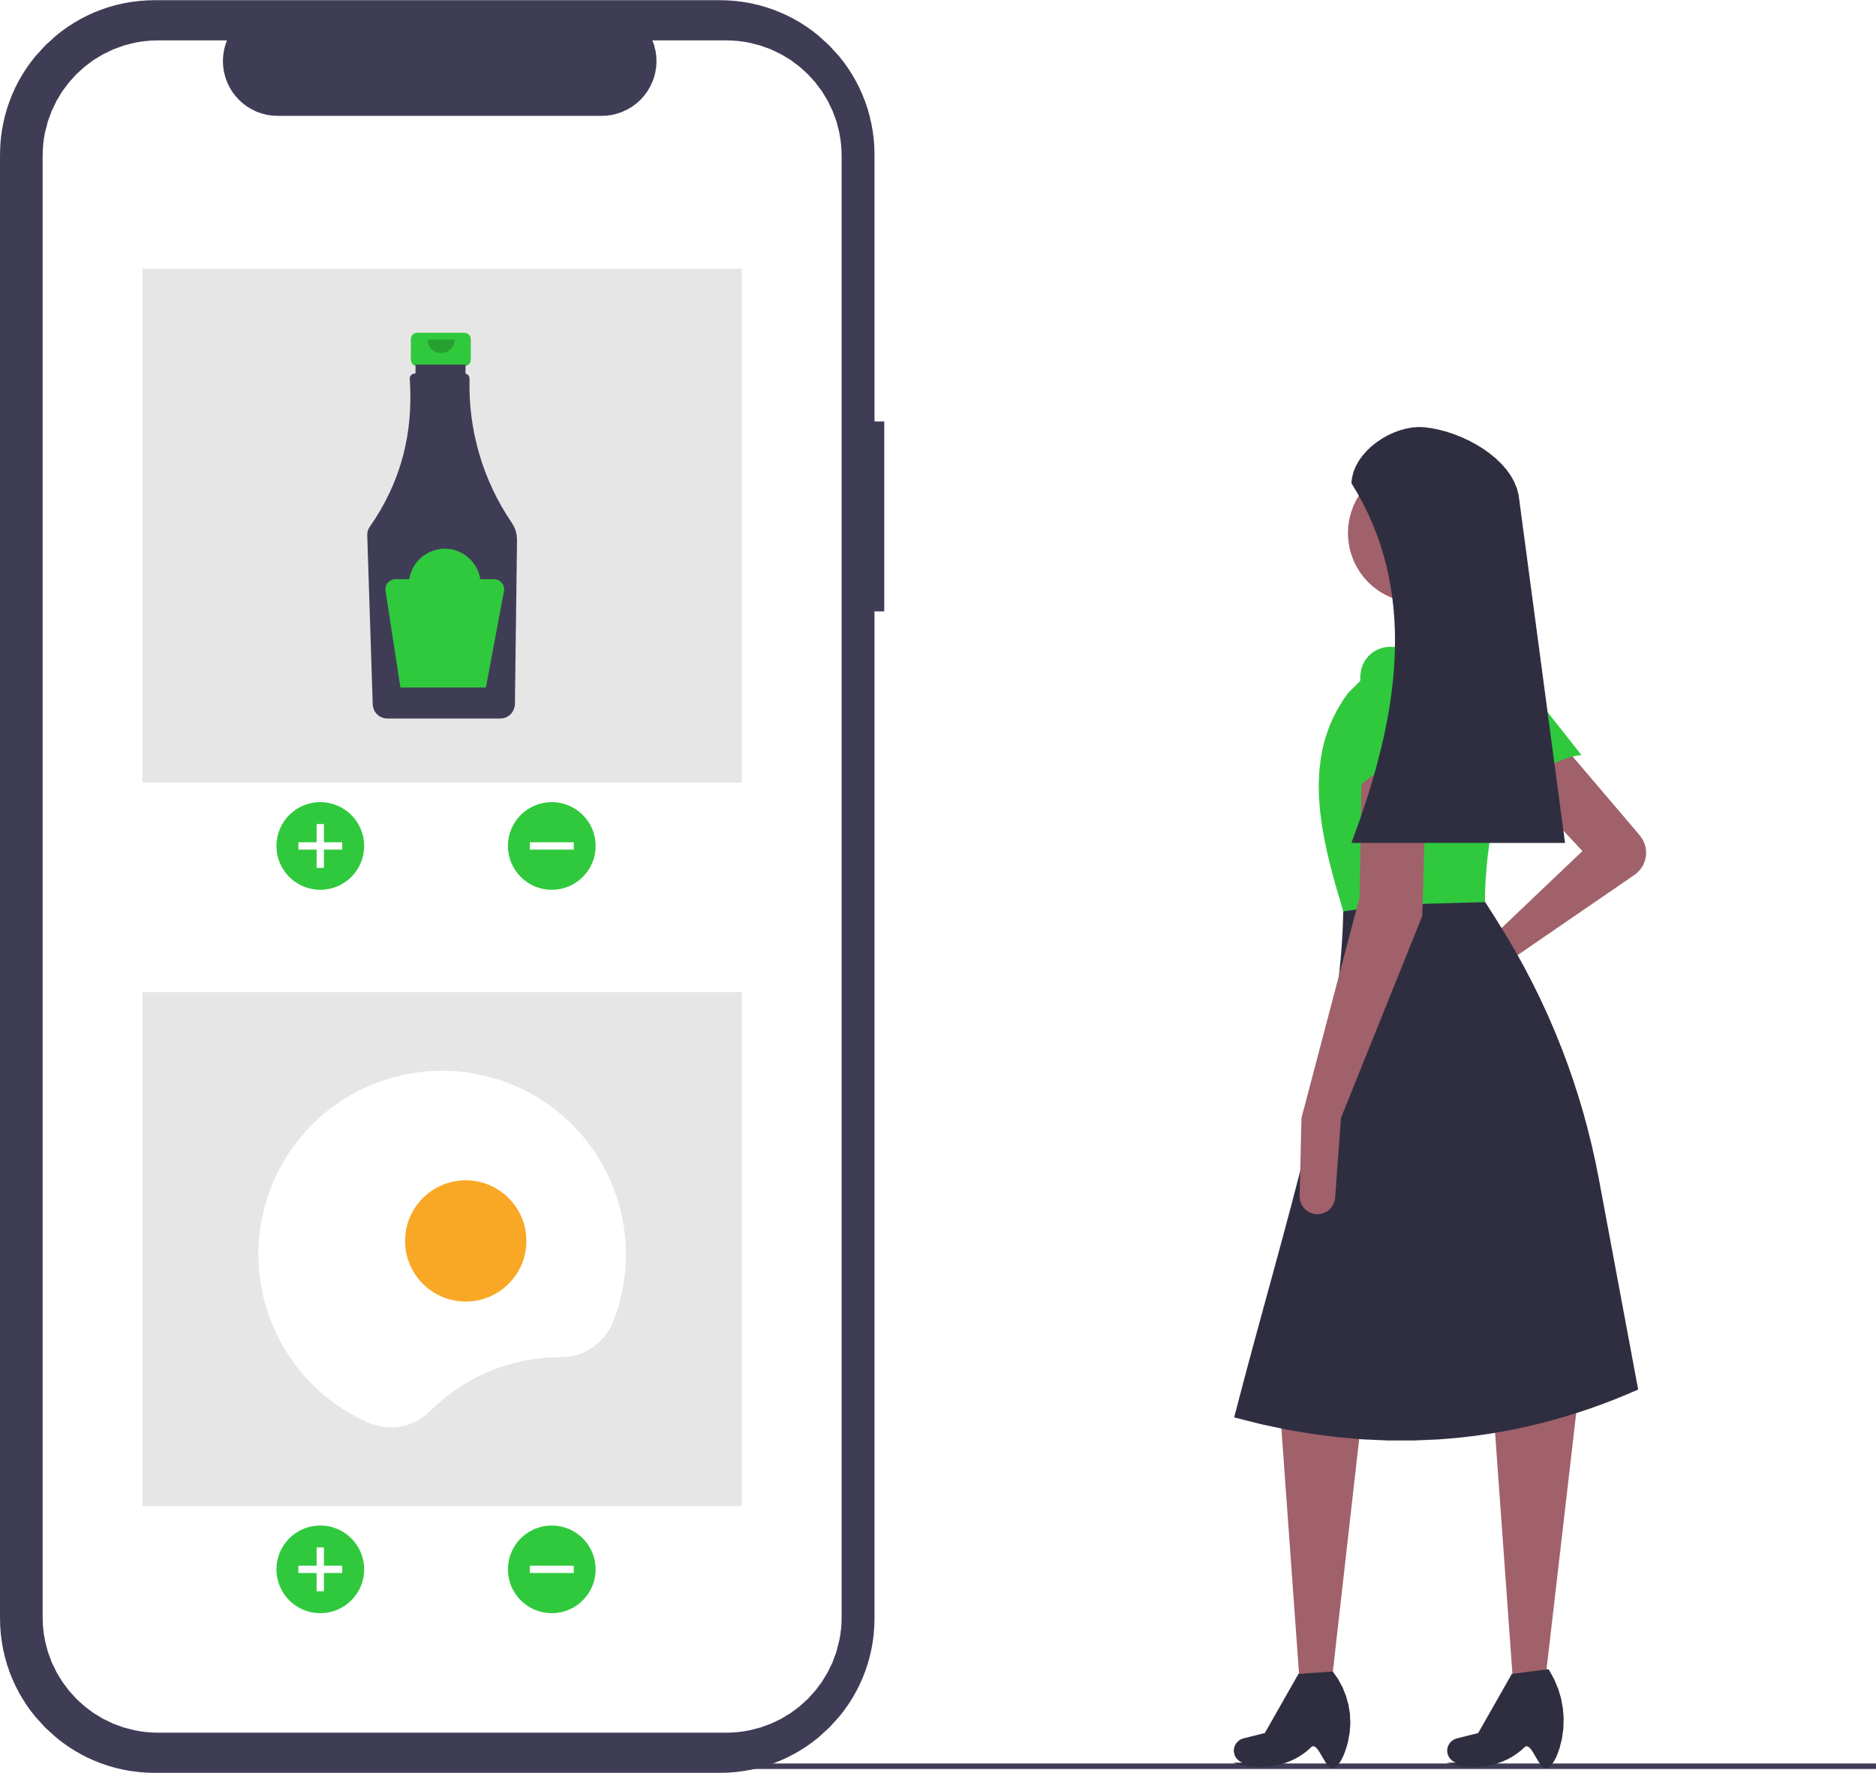
Introduction
ABOUT COLLIGO
It’s a smart way to help small shopkeepers promote their business in the neighbourhood.
It’s easy and fast to contact shops and take away the ready-made shopping.
It’s safer to buy products where relationships between costumers and operators already exist.

Slide 5
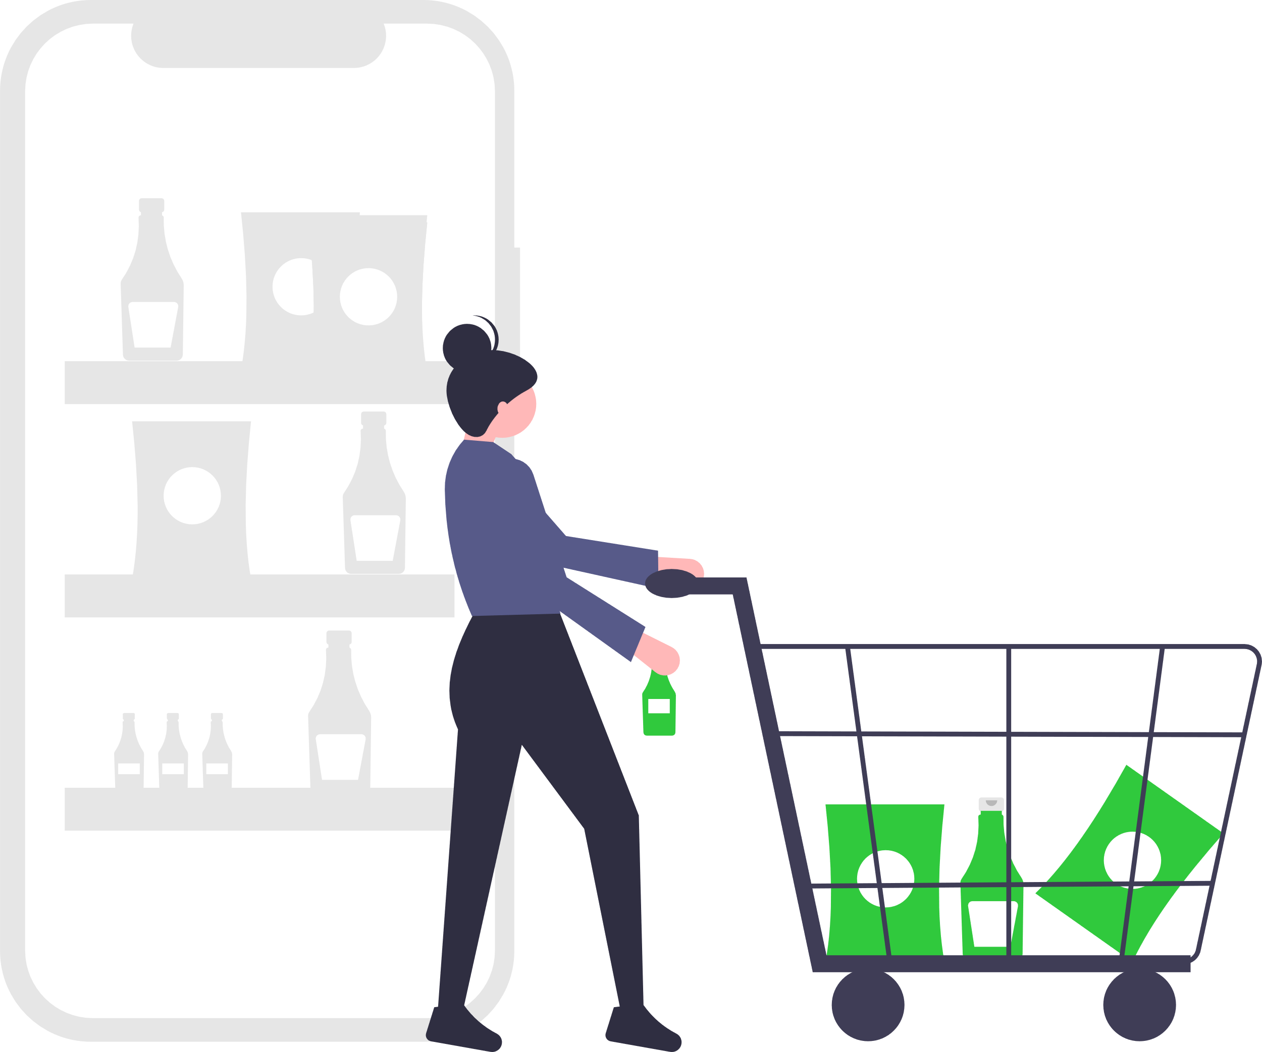
Introduction
WHY COLLIGO
In this moment, everybody needs a way to avoid infection doing grocery shopping.
Every small/medium business is smashed by GDO.
The project is born thanks to the solidarity of a small group made up of common people.

Slide 6
02
REQUIREMENT ANALYSIS
Preliminary information to identify the target

Slide 7

Requirement Analysis
COMPETITORS
QUESTIONNAIRE
USER
Analysis of functionalities of the main competitors
Questionnaire results used to validate and improve our original idea
Analysis of the average user with related scenario

Slide 8
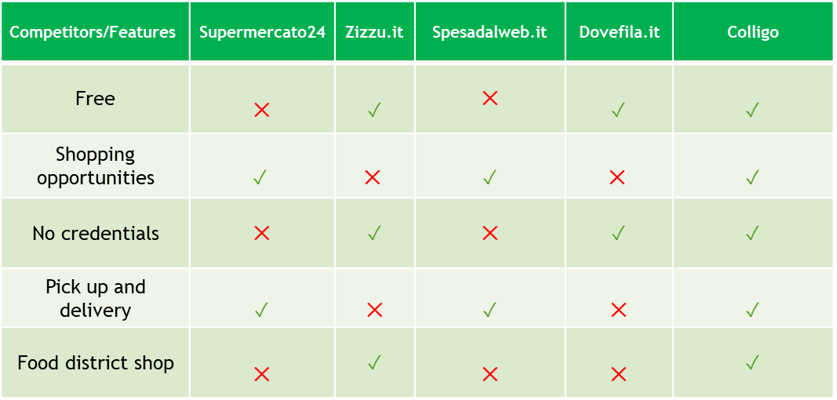
Competitor
Competitor analysis

Slide 9
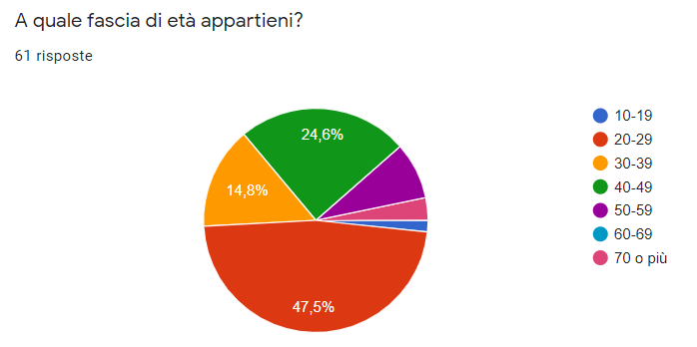
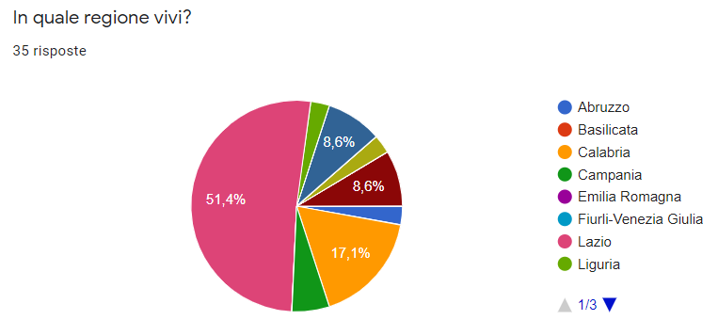
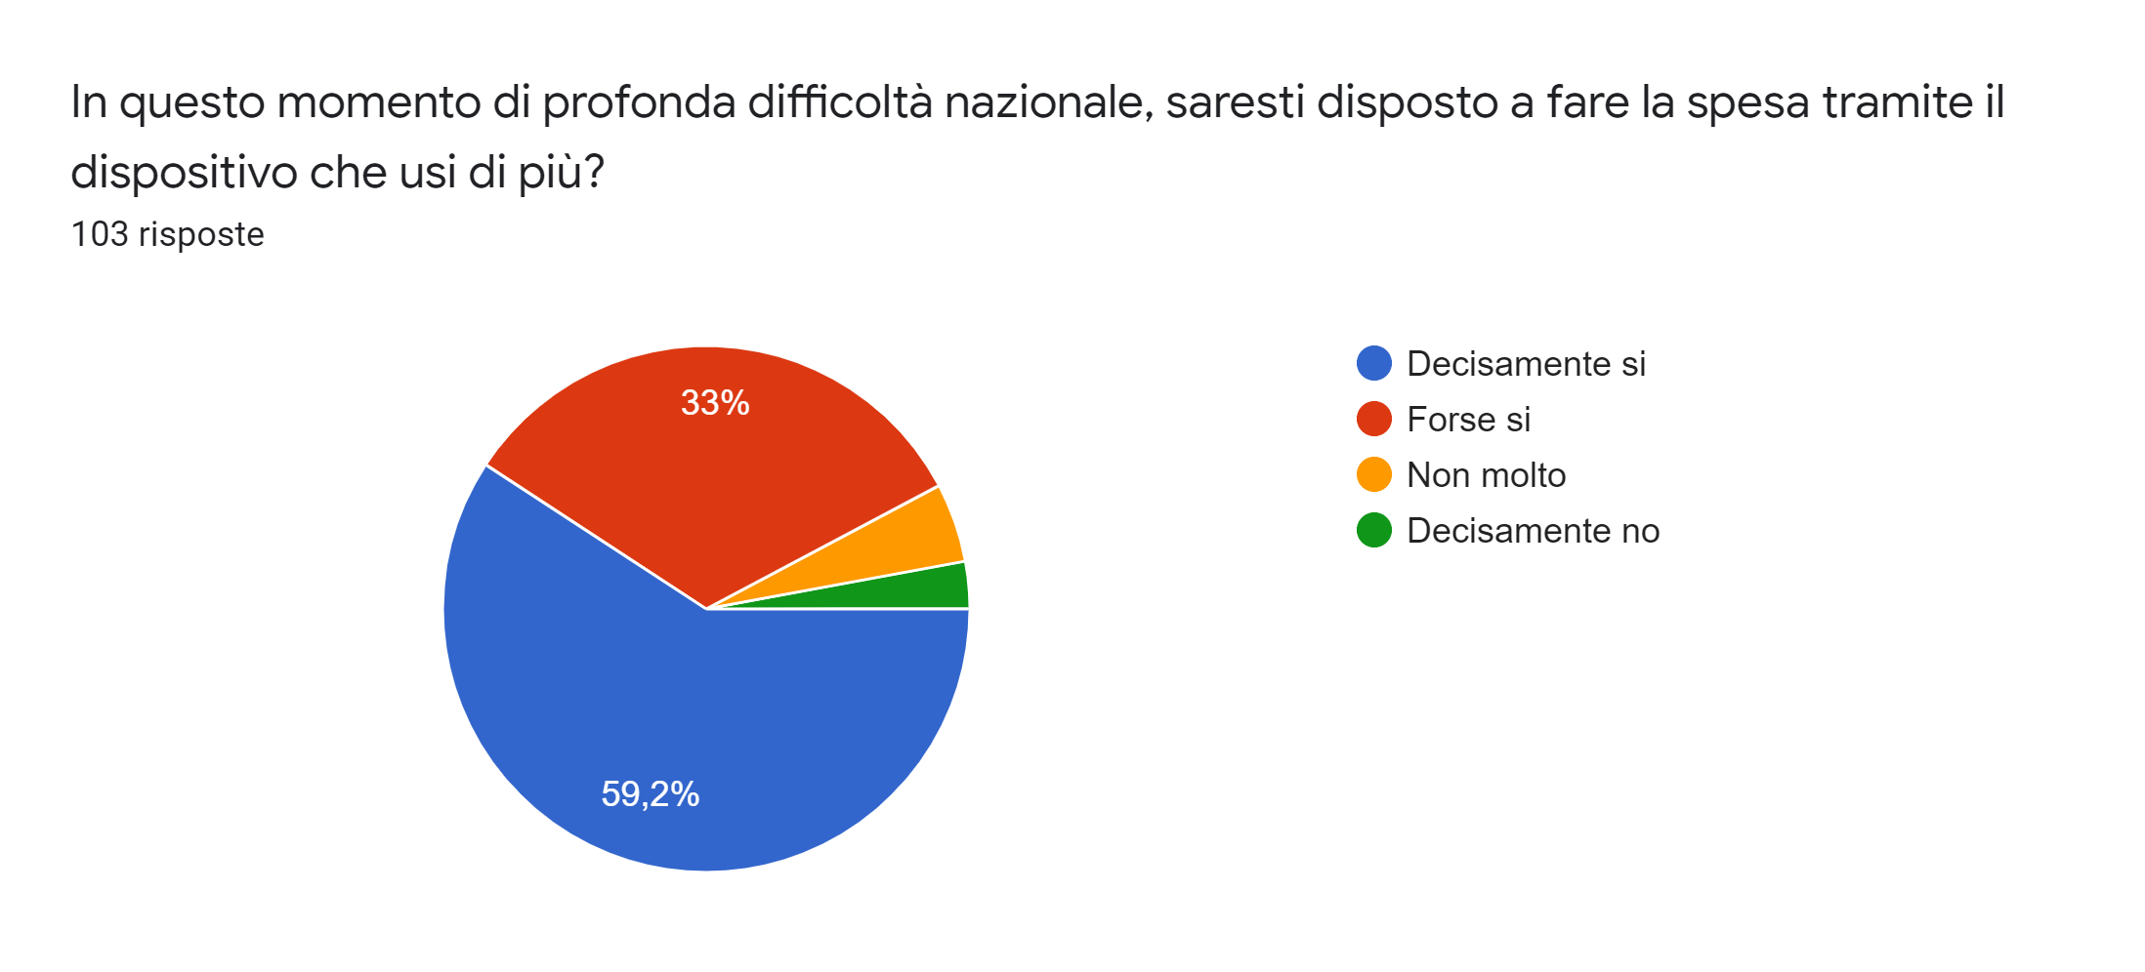
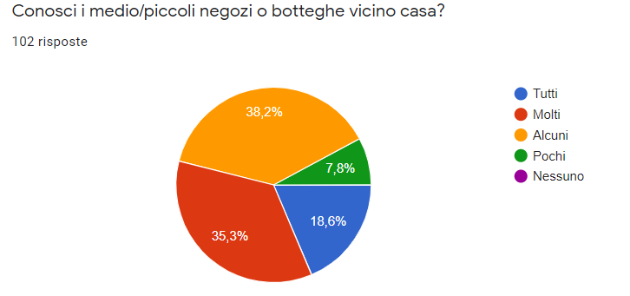
Questionnaire
Questionnaire analysis: general information

Slide 10
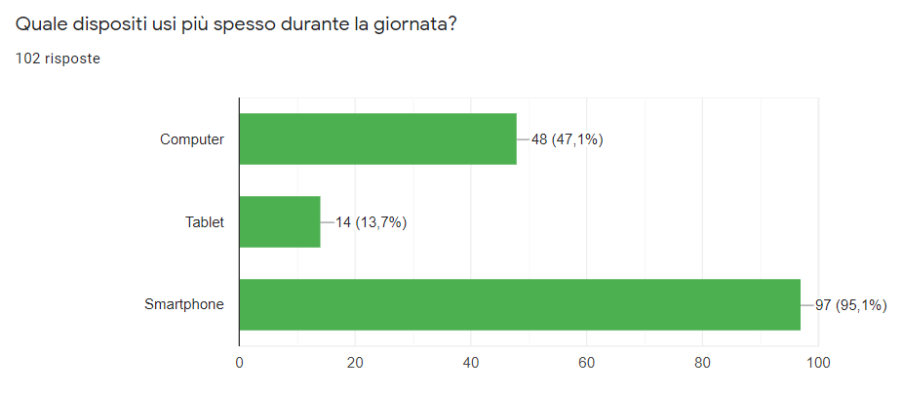
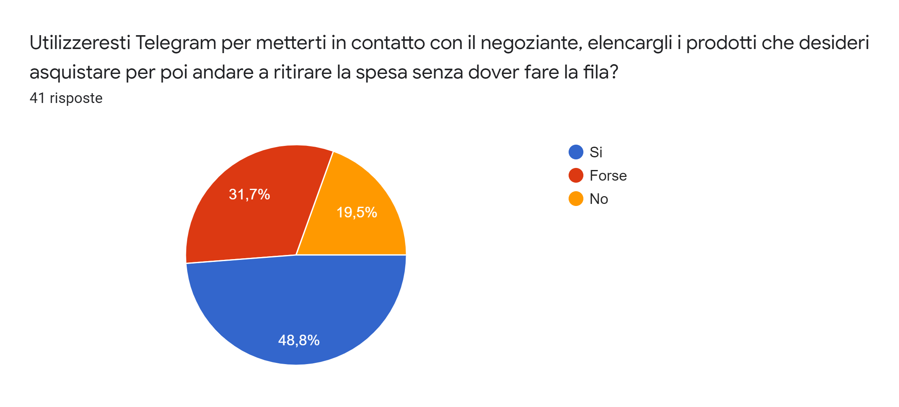
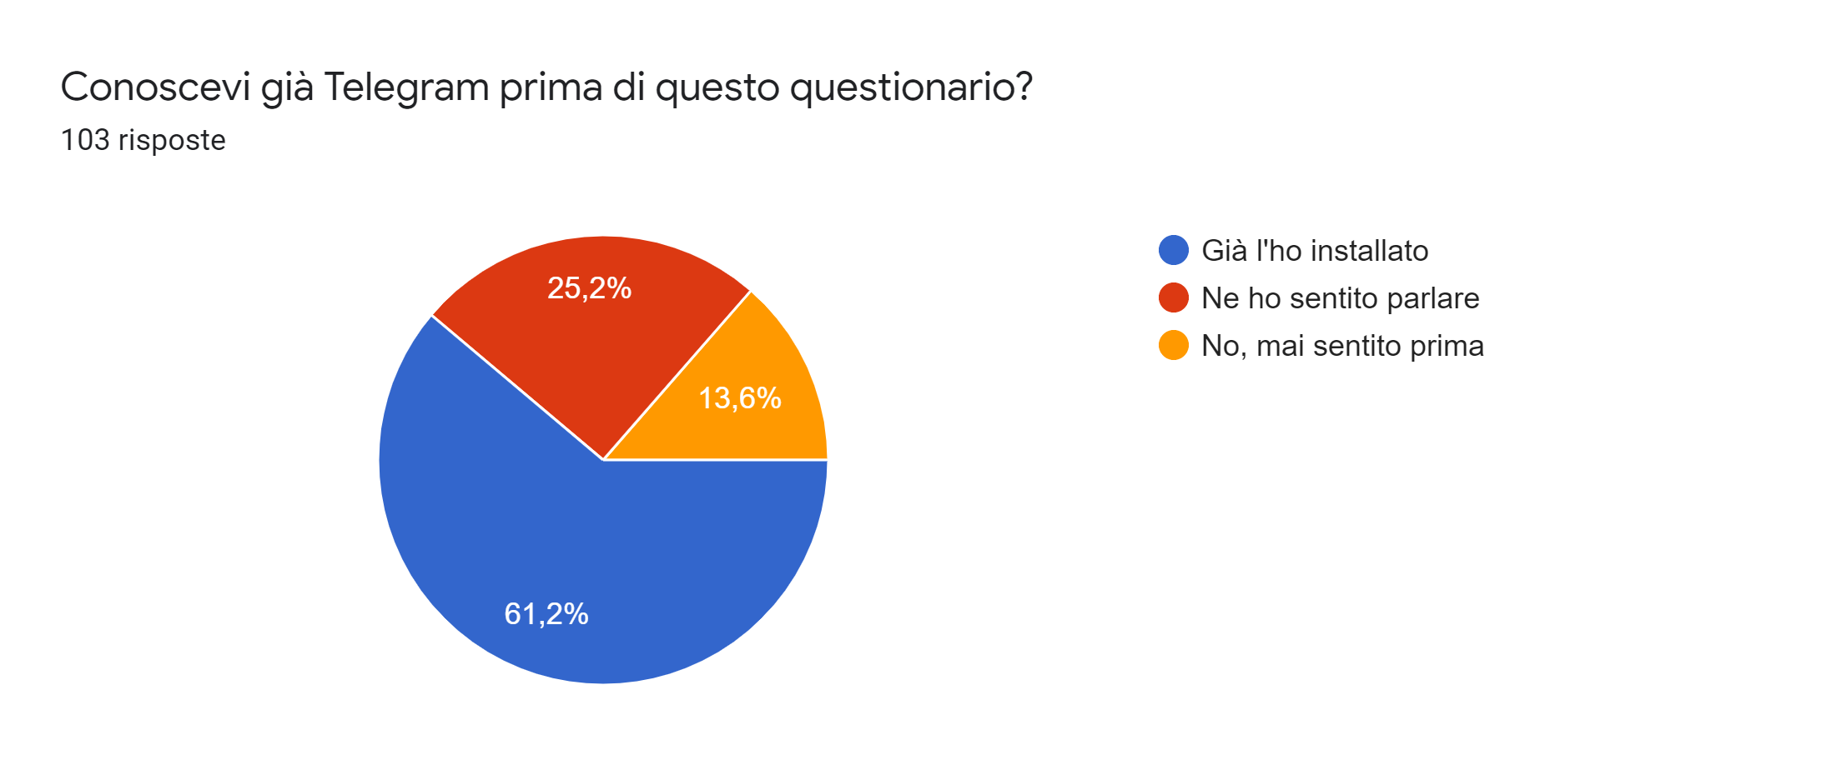
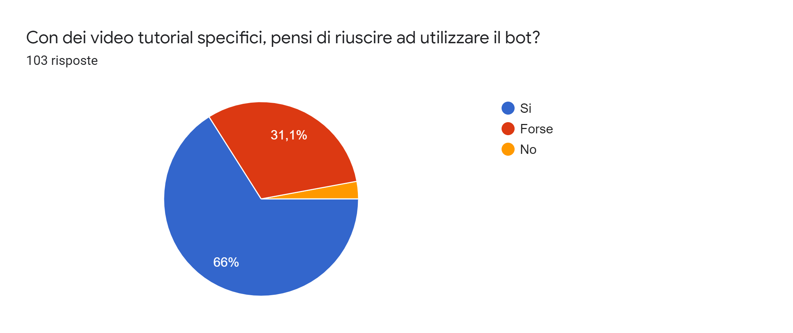
Questionnaire
Questionnaire analysis: Technology

Slide 11
Questionnaire
Questionnaire analysis: conclusions
From the results of the Questionnaire we can understand that:
18-49 years old covers more than 75% of users
Almost everyone uses their smartphone
Good knowledge of local shops
Interest in using an alternative purchasing method
Tutorial encourages the user to use the application

Slide 12
User
User analysis
Age: 18-49
Gender: Equally distributed
Location: Everywhere, especially in Lazio
Technology: A smartphone and Internet connection

Slide 13
03
TASK ANALYSIS
The HTA diagram captures the tasks that a product will perform through user interaction, which is represented by the STN

Slide 14
Task Analysis
Task Analysis: HTA and STN
Operator registration: In order to perform this task, the user has to add the bot as admin in a group and he has to fill the required fields.
0. Registration
Plan 0: 1 – if necessary 2 – 3 – 4
1.
Init Group
2.
Insert Web Page
3.
Insert Shop Data
Plan 1: Do 1.1 – 1.2 in this order
Plan 3: Do 3.1 – 3.2 in any order
1.1
Create Group
1.2
Appoint it
as Admin
3.1
Add Category
3.2
Add Position
Plan 1.1: Do 1.1.1 – 1.1.2 in this order
Plan 3.1: Do 3.1.1 – 3.1.2 in this order
Plan 3.2: Do 3.2.1, if it failure then 3.2.2
1.1.1
Set Title as
Shop Name
1.1.2
Add Bot
3.1.1
Choose
Category
3.1.2
Confirm Choice
3.2.1
Default Sharing
3.2.2
Write
Address
Plan 3.2.1: Do 3.2.1.1 – 3.2.1.2 – 3.2.1.3 in this order
3.2.1.1
Pick Branch
3.2.1.2
Push Position Button
3.2.1.3
Share Current
Position

Slide 15
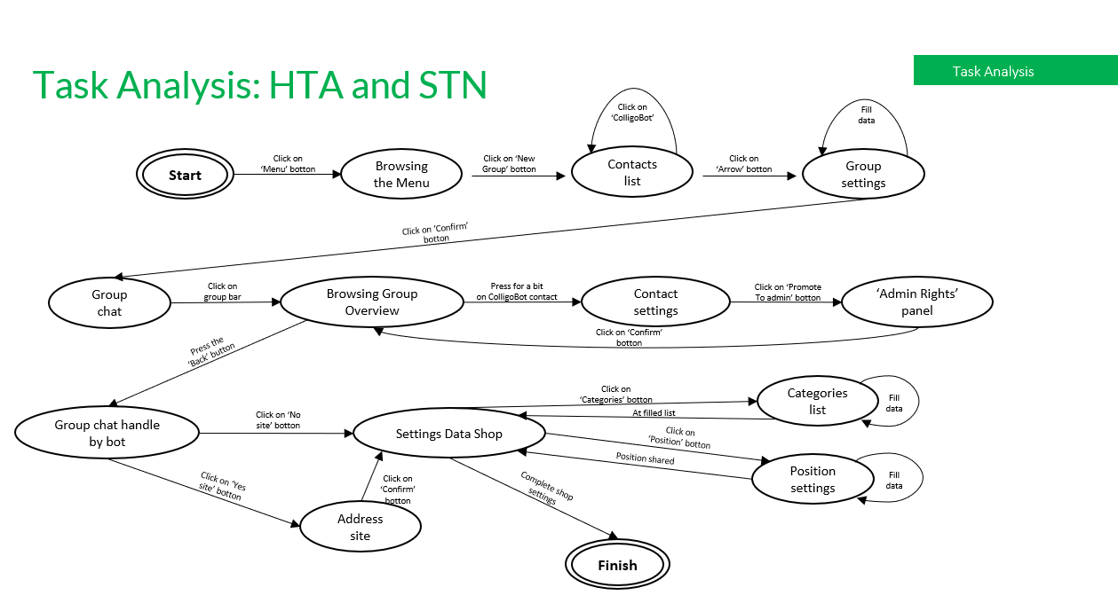

Slide 16
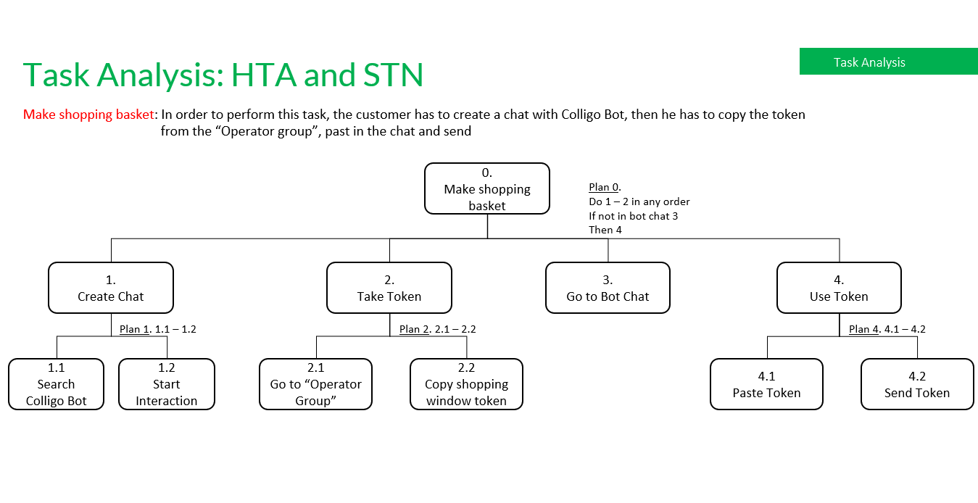

Slide 17
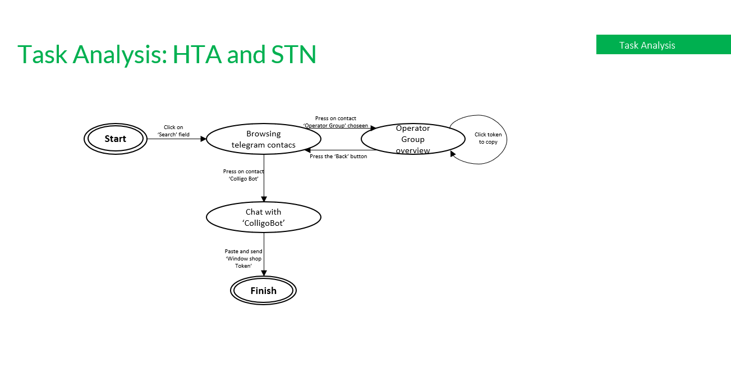

Slide 18
04
PROTOTYPE 0 : MOCKUPS
GUI and main functions

Slide 19
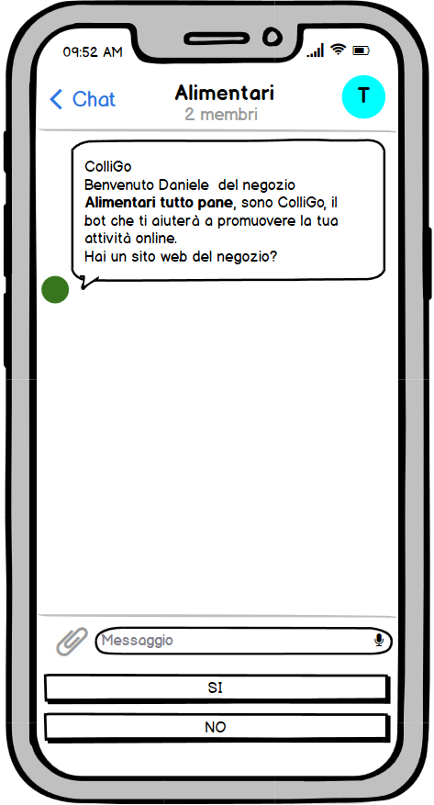
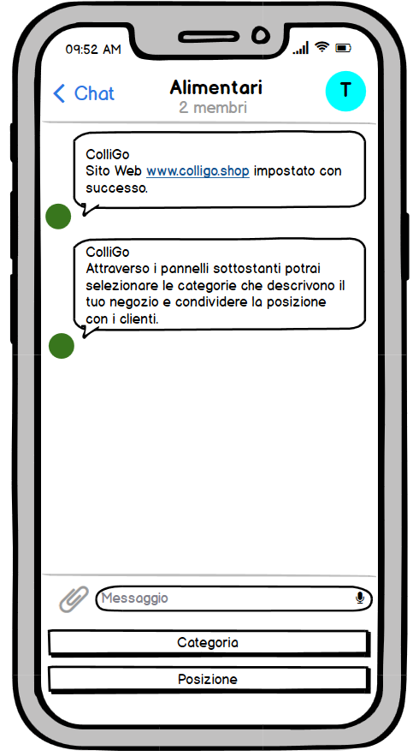
Mockups
Prototype 0 : Mockups
Step0: Operator’s registration

Slide 20
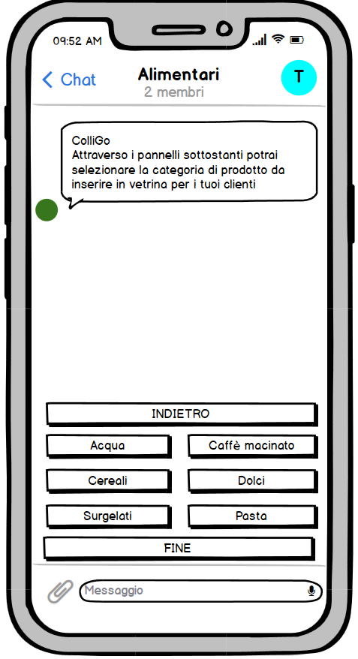
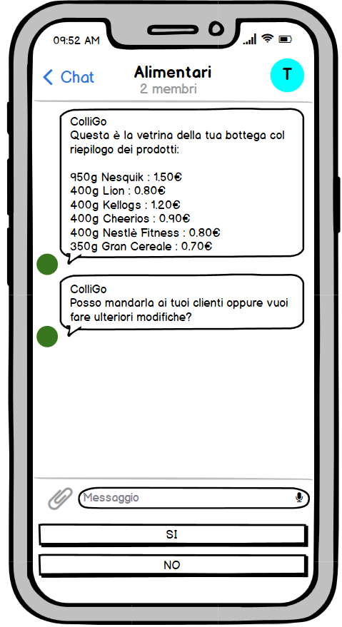
Mockups
Prototype 0 : Mockups
Step1: Storefront

Slide 21
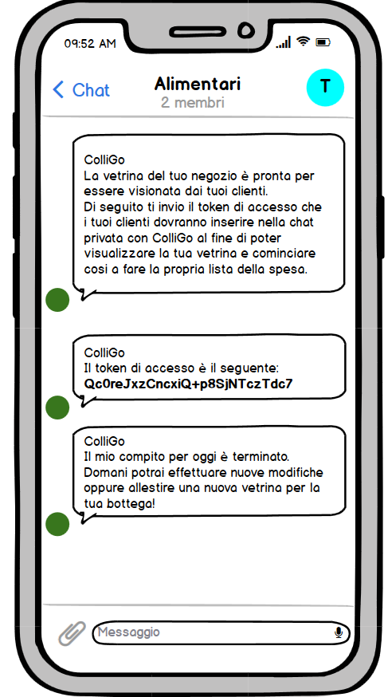
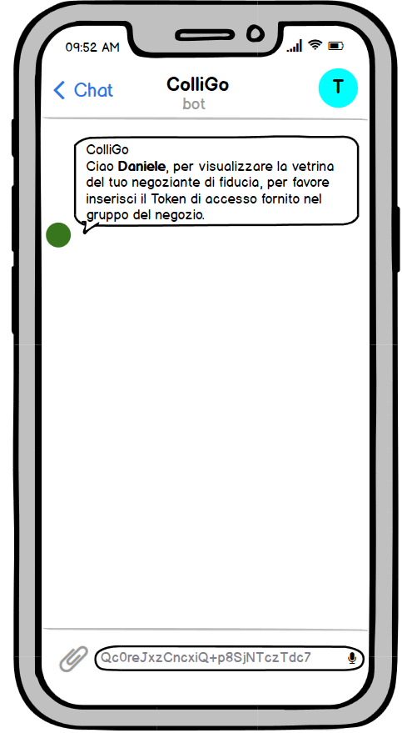
Mockups
Prototype 0 : Mockups
Step2: Access with Token

Slide 22
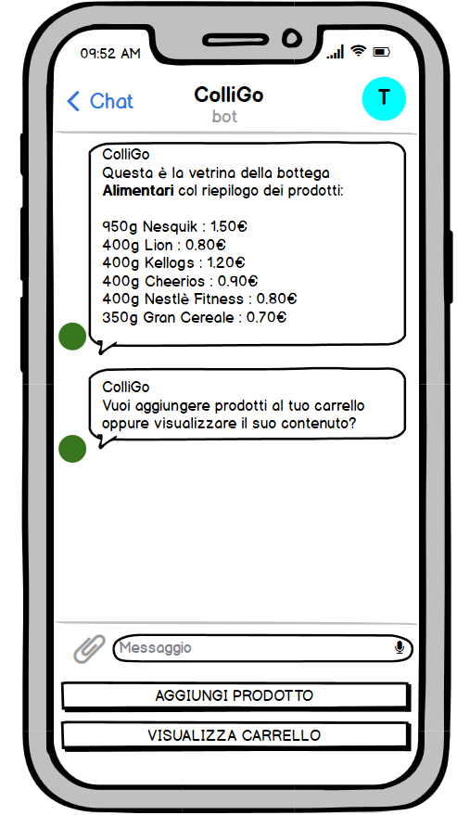
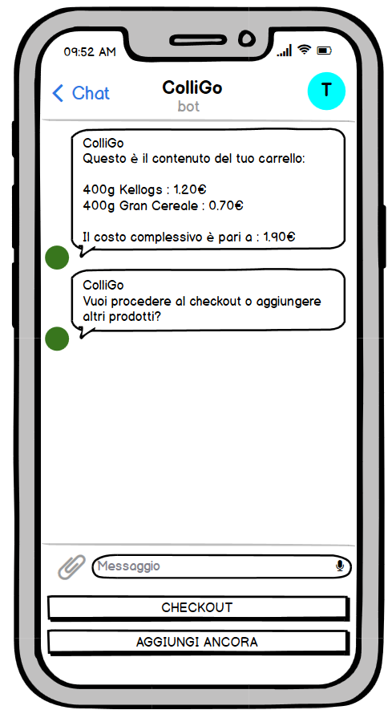
Mockups
Prototype 0 : Mockups
Step3: Customer's shopping

Slide 23
05
USED TECNOLOGIES

Slide 24
Used Tecnologies
Used Tecnologies
Python 3.5
python-telegram-bot library
Geopy and GoogleMaps library
Bs4 library
Hashlib library

Slide 25
Used Tecnologies
Python 3.5
Python is an interpreted, high-level, general-purpose programming language. Created by Guido van Rossum and first released in 1991, Python's design philosophy emphasizes code readability with its notable use of significant whitespace. Its language constructs and object-oriented approach aim to help programmers write clear, logical code for small and large-scale projects.
Python 3.5.0 was released on September 13th, 2015 to improve new features and changes.

Slide 26
Used Tecnologies
python-telegram-bot
This library provides a pure Python interface for the Telegram Bot API. It’s compatible with Python versions 3.5+ and PyPy.
In addition to the pure API implementation, this library features a number of high-level classes to make the development of bots easy and straightforward. These classes are contained in the telegram.ext submodule.
All types and methods of the Telegram Bot API 4.8 are supported.

Slide 27
Used Tecnologies
Geopy and GoogleMaps
Geopy is a Python 2 and 3 client for several popular geocoding web services. Geopy makes it easy for Python developers to locate the coordinates of addresses, cities, countries, and landmarks across the globe using third-party geocoders and other data sources.
GoogleMaps is a Python Client library for the following Google Maps APIs:
Directions API
Distance Matrix API
Elevation API
Geocoding API
Geolocation API
…

Slide 28
Used Tecnologies
Bs4 library
Beautiful Soup is a Python library for pulling data out of HTML and XML files. It works with your favorite parser to provide idiomatic ways of navigating, searching, and modifying the parse tree. It commonly saves programmers hours or days of work.

Slide 29
Used Tecnologies
Hashlib library
This module implements a common interface to many different secure hash and message digest algorithms. Included are the FIPS secure hash algorithms SHA1, SHA224, SHA256, SHA384, and SHA512 (defined in FIPS 180-2) as well as RSA’s MD5 algorithm (defined in Internet RFC 1321). The terms “secure hash” and “message digest” are interchangeable. Older algorithms were called message digests. The modern term is secure hash.

Slide 30


THANKS!
https://colligo.shop/home
https://github.com/LucaTomei/Reti-di-Calcolatori---Colligo-Telegram-Bot

